Slide 1
Home Sensor w/ Reasoning
Team EcoNest

Slide 2
Problem Background
Context
Modern homes increasingly rely on multiple smart devices that provide basic notifications but lack the ability to perform contextual reasoning across devices.
Why it matters
Homeowners lack clear insight into their home’s energy consumption and security status, making it difficult to:
Identify inefficiencies
Detect meaningful events
Make informed decisions
Current Limitations
Smart device platforms typically provide raw, unprocessed sensor data
Limited ability to correlate data across devices
Lack of prioritization or intelligent interpretation of events
Key statistics
Idle energy consumption accounts for 5-10% of residential energy usage.
A burglary occurs roughly every 25-30 seconds in the U.S.
The smart home market is expected to grow at a 27.07% CAGR over the next 5 years, increasing the need for integrated, intelligent monitoring solutions.

Slide 3
Needs Statement
Who has the need?
Homeowners using multiple smart home devices (e.g., smart plugs, motion sensors, sound sensors) who require meaningful insights and reasoning about their home’s energy usage and security.
What is missing?
A centralized system that:
Aggregates data from diverse smart devices.
Interprets sensor data across sources.
Provides contextual reasoning for energy consumption and security events.
Why is a solution necessary?
Despite widespread adoption of smart devices:
Data is fragmented across multiple platforms.
Users receive raw sensor output without context or prioritization.
Homeowners lack the ability to assess risks or inefficiencies effectively.
Impact if unmet
Delayed or missed responses to security threats.
Increased energy inefficiency and costs.
Continued reliance on disconnected data with no actionable guidance.

Slide 4
Goals and Objectives
Main Goal:
Develop a centralized smart home monitoring system that applies data driven reasoning to optimize energy consumption and enhance home security.
Objectives:
Collect and integrate multi-modal sensor data (energy, motion, sound) for analysis and model training.
Enable reliable and secure data transmission from devices to the central system.
Detect anomalies in real time to identify:
Abnormal energy usage
Potential security threats
Analyze historical data to identify trends and support predictive decision-making.
Generate actionable recommendations for improving energy efficiency and security.
Provide users with a visual interface to monitor system status and receive timely notifications.

Slide 5
Energy Requirements
Energy Collection
The system shall collects energy data from each monitored device every 30 seconds
Each device shall report:
Voltage (V)
Current (A)
Power (W)
Total Energy Consumption (kWh)
Device Monitoring
The system shall support monitoring of multiple devices over WiFi
Each device shall have a unique identifier associated with a specific home/unit
Data Storage
The system shall transmit all sensor data to a central SQL database.
Each data entry shall include:
Timestamp (universal time)
Device Identifier
The system shall maintain a continuous historical record of energy usage.

Slide 6
Security Requirements
Environmental Monitoring
Motion and sound sensors shall operate continuously (24/7) while powered.
Sound Detection
The system shall measure environmental noise in decibels (dB)
The system shall log events when noise exceeds a configurable threshold (30 dB)
Motion Detection
The system shall detect motion within sensor range.
The system shall log:
Time of detection
Duration of motion
Event Logging
The system shall timestamp all motion and sound events.
The system shall correlate motion and sound data to identify potential activity patterns.
AI/ML Integration
The system shall provide collected sensor and event data as input to AI/ML model.
The AI/ML model shall perform reasoning such as anomaly detection or activity inference.

Slide 7
Design Alternatives
Cloud Database (AWS): Moved from local storage to AWS for more reliable data storage and easier access for analysis
Home Assistant via Docker on Raspberry Pi: Replaced a rigid deployment setup with Docker for a more flexible environment and remote device access
Breaker-Level Energy Monitoring: Switched from smart plugs to measurement tools connected directly to electrical breakers for more accurate and comprehensive energy tracking
Sound Microphones over Sound Sensors: Original sound sensing approach could not produce meaningful data, so we switched to microphones plugged directly into the Raspberry Pi to capture sound magnitude effectively
Motion Sensor Hub Requirement: Discovered that motion sensors for Units 2 and 3 require a hub to operate; resolved by leveraging Home Assistant compatibility to integrate them into the existing architecture

Slide 8
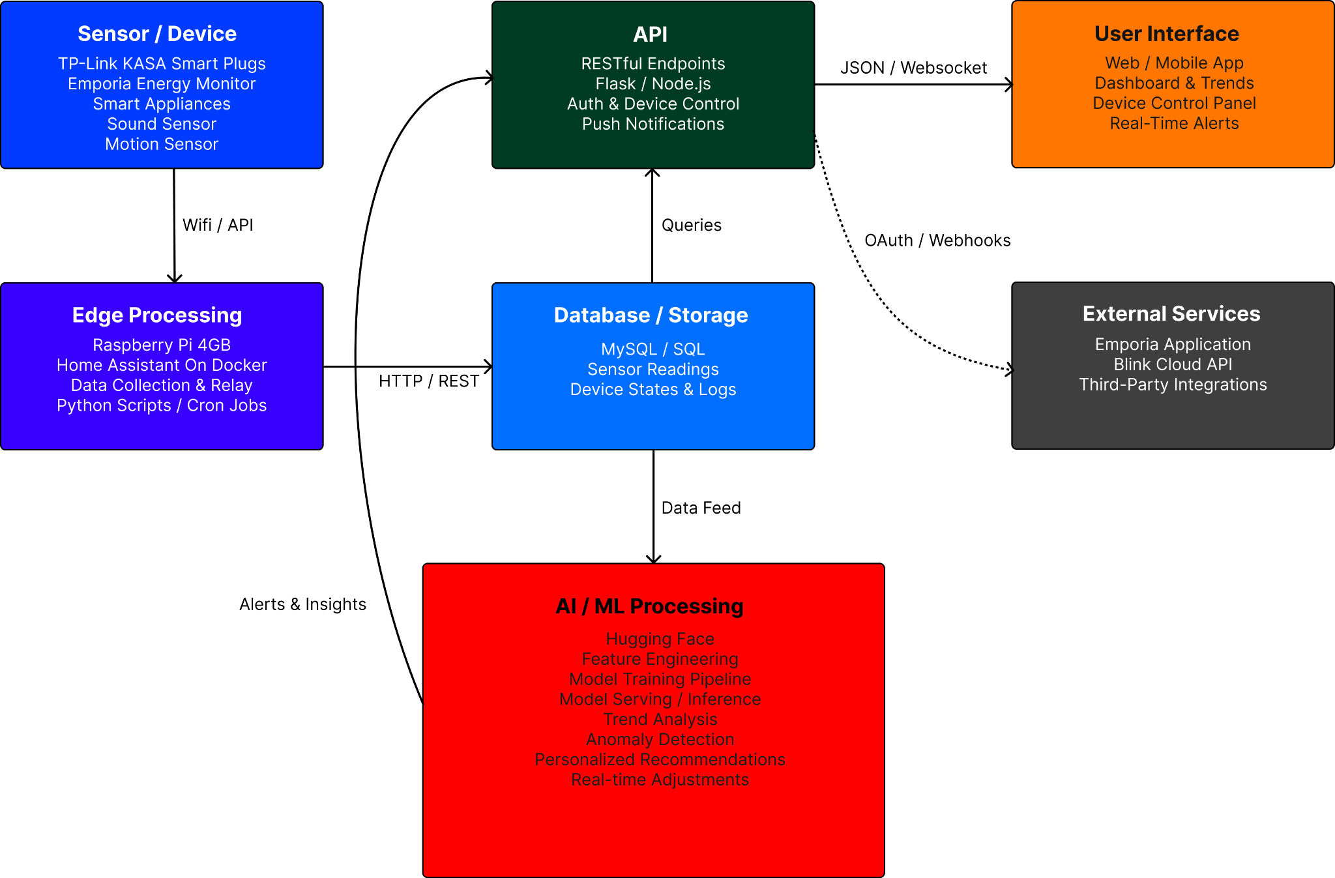
System-Level Description

Slide 9
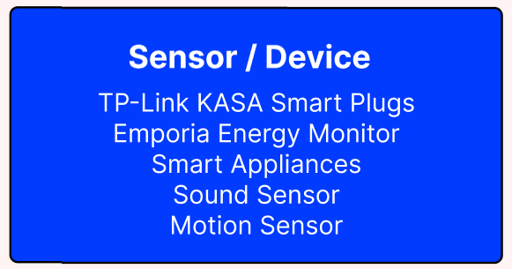
Sensors/Devices
Kasa Smart Plugs:
Captures devices energy output
(Current, Voltage, Power, etc.)
Currently set up in unit 1 or 2
Emporia Vue Energy Monitor + Emporia Energy Plugs
Installed directly into the breaker box
Clamps onto each individual breaker and measures energy output (voltage, current, power, energy usage (kWh))
Gives a per-appliance data
Current set up in unit 3
Zigbee Dongle and Presence Detector
Detects motion using infrared (body heat)
Gives data of motion detected (1) or no motion detected (0)
Microsoft USB Microphone
Detects sound based on environment and tracks if there is a spike is noise, which will be logged
All of these are either physically connected or managed off the Raspberry Pi

Slide 10
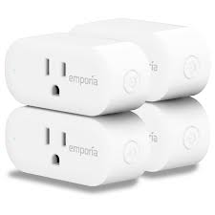
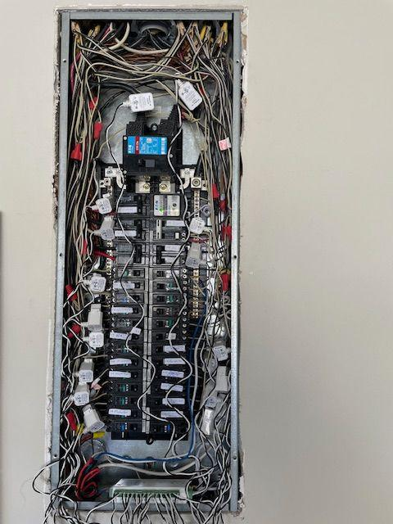
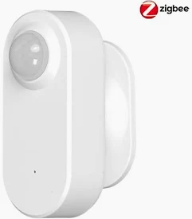
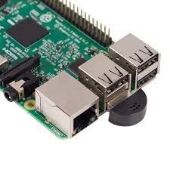
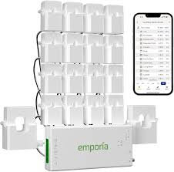
Pictures
Energy Monitoring Security (Motion + Sound)

Slide 11
Testing/Validation
Smart Plug Energy Monitoring
Test:
Connect appliances with known power consumption.
Compare smart plug readings with expected wattage.
Validation:
Energy readings are within +/- 10% of expected values.
Continuous monitoring works without data loss.
Motion Sensor Detection
Test:
Perform controlled movements in area at different locations and angles.
Validation:
Motion is detected.
Detection accuracy greater than 90%
Sound Sensor Detection
Test:
Simulate normal and abnormal sound levels (loud noise, glass breaking, etc.)
Validation:
Sensor differentiates between normal and abnormal sound levels.

Slide 12
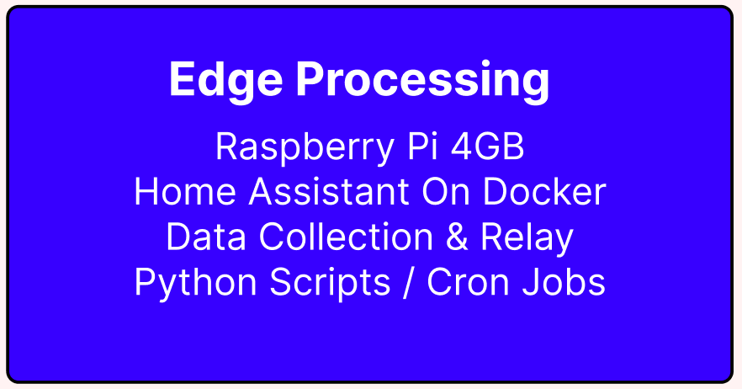
Edge Processing
Role in Our System
Local decision-making for real-time security events
Reduces latency (no cloud delay for alerts/actions)
Maintains functionality even if internet is down
What Runs on the Edge
Home Assistant (Dockerized)
Device coordination and automation engine
Sensor Data Collection & Filtering
Motion, sound, camera triggers processed locally
Event Detection Logic (Python / Cron Jobs)
Detect suspicious patterns (unexpected motion, noise spikes)
Data Relay
Sends relevant events to cloud/dashboard (not raw data)
Why Edge Processing Matters
Faster alerts (instant response vs cloud round-trip)
Improved privacy (sensitive data stays local)
Lower bandwidth usage

Slide 13
Testing/Validation
End-to-End System Testing
Simulated real home scenarios (motion, sound, energy)
Verified full pipeline: Sensors → Home Assistant → API → Database
Key Tests Performed
Motion Detection:
Controlled movement at different angles and distances
Sound Detection:
Normal vs abnormal noise (e.g., loud spikes)
Energy Monitoring:
Compared readings against known appliance usage

Slide 14
Testing/Validation
System Validation
Accurate detection across all sensor types (>90%)
Energy readings within ±10% of expected values
Reliable data transmission with no significant loss
Alerts triggered correctly for abnormal events
Performance Results
Near real-time alert response (< 2 seconds)
Stable operation under continuous data collection

Slide 15
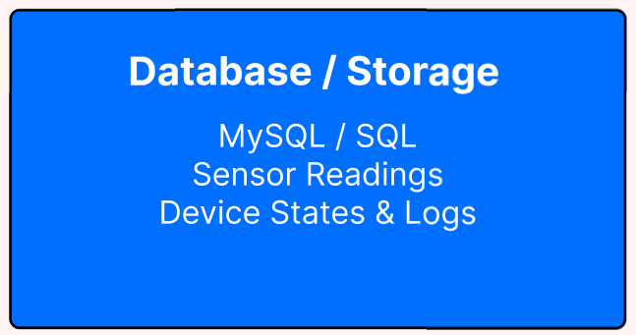
Database: Overview
Platform Selection:
The system uses a MySQL relational database hosted on Amazon RDS (AWS)
Stored Data:
The database maintains structured records for:
Homes (user environments)
Devices (associated with each home)
Sensor Readings (time-series energy and environmental data)
Data Representation:
The data is stored using MySQL JSON fields to support flexible schemas for different device types
Design Rationale:
Relational Structure supports clear relationships between homes, devices, and data
Efficient Querying enables analytics, trend analysis, and AI/ML processing
Cloud Hosting provides scalability, reliability, and managed backups
The system is designed to handle high-frequency time-series data.

Slide 16
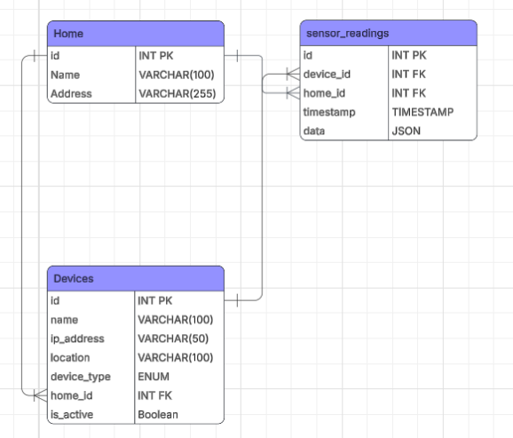
Database: ER Diagram
Database Schema
Tables:
Homes
Devices
Each device relates to a home
Sensor Readings
Each sensor reading relates to a device and a home
AI/ML Data Support
We plan to add a table capable of storing data required for our AI/ML models.
If future AI workloads require more complex relationships, the system is designed to integrate additional data stores as a graph database without disrupting core architecture

Slide 17
Database: Performance & Scalability
Expected Workload:
Our focus will be on unit 3 which will contain 30 devices.
We are going to sample every 30 seconds for the smart plugs which are 28 of them.
This results in about 3,360 readings per hour
Write Performance:
The system will have frequent inserts (every 30 seconds per device)
It will be insert only and not updates to minimize write overhead
Read Performance:
We use indexing to speed up querying (device id and timestamp, home id and timestamp)
Scalability Strategy:
Using Amazon RDS supports vertical scalability allowing for upgrading instances and storage size.

Slide 18
Database: Design Tradeoffs
Decision | Alternative | Rationale | Tradeoff
SQL (MySQL) | NoSQL | Structured data, strong relationships | Less flexible
JSON fields | Fully normalized | Flexible schema | Complex queries
AWS RDS | Local DB | Scalable, managed | Cost

Slide 19
Database: Validation Plan
Data Ingestion:
Test: Verify sensor data is received every 30 seconds
Method: Compare timestamps of incoming data
Success Criteria: ≥98% of expected readings received
Data Storage:
Test: Ensure all incoming data is stored correctly
Method: Insert known data and query database
Success Criteria: 100% data accuracy, no loss
System Performance:
Test: Measure database performance under load
Method: Simulate multiple devices sending data
Success Criteria:
Event detection latency: < 2 seconds
Data insertion latency: < 1 second per reading

Slide 20
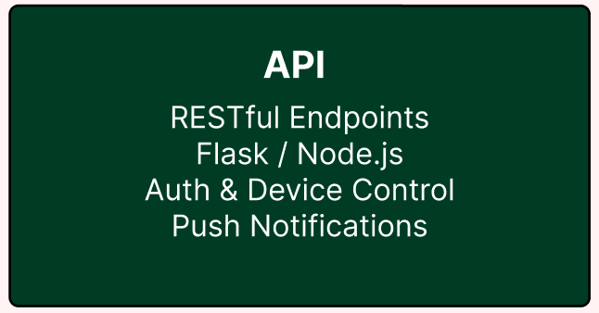
API: Overview
Purpose:
Acts as a central interface between system components
Enables communication between:
Sensors/Devices
Database
UI
AI/ML Processing
Architecture:
Implemented as a RESTful API
Use standard HTTP methods (GET, POST)
Stateless design for scalability and simplicity
Core Responsibilities:
Receive and validate sensor data from devices
Store data in database
Provide data access for UI and AI/ML processing
Design Rationale:
REST was chosen for:
Simplicity and ease of implementation
Scalability in distributed systems

Slide 21
API: Endpoints
Device Management:
/devices/list
GET
Lists all devices
/devices/add
POST
Adds a device
Sensor Data Inserts:
/readings/add
POST
Adds all readings given
/readings/list/<device_id>
GET
Lists all readings of a given device
Structure:
All endpoints use JSON for data exchange

Slide 22
AI/ML Pipeline Overview
Architecture:
The system uses a multi-stage AI reasoning pipeline hosted on AWS, with Amazon Bedrock as the LLM integration layer and MySQL on Amazon RDS as the data backbone
Data Flow:
The pipeline processes incoming sensor readings through four stages before reaching the reasoning agent:
Sensor Readings (raw motion, sound, and power data)
Trigger Check (rule-based gate that determines if a reading is worth reasoning about)
HomeContext JSON (structured input assembled from all data sources and sent to the LLM)
Reasoning Agent (Amazon Bedrock with Claude 3 Haiku producing alerts and recommendations)

Slide 23
AI/ML Pipeline Overview
Supporting Data Sources:
Short-Term Home Snapshot: captures current home state including occupancy estimate, power trend, sound spikes, and active devices
Long-Term Home Analytics: stores hourly precomputed baselines via AWS EventBridge Lambda including motion probability, avg power, and baseline sound levels
Device Profiles: store static per-device constraints such as expected watt range, max idle time, and active hours for anomaly thresholds
Design Rationale:
Trigger-based LLM invocation ensures the LLM (Claude 3 Haiku) is called only for genuine anomalies or scheduled daily reviews, keeping costs low and responses fast
Separation of short-term and long-term data allows the Reasoning Agent to distinguish between current home state and historical behavioral norms
Structured JSON output ensures alerts and recommendations are always consistent for the user interface and SMS

Slide 24
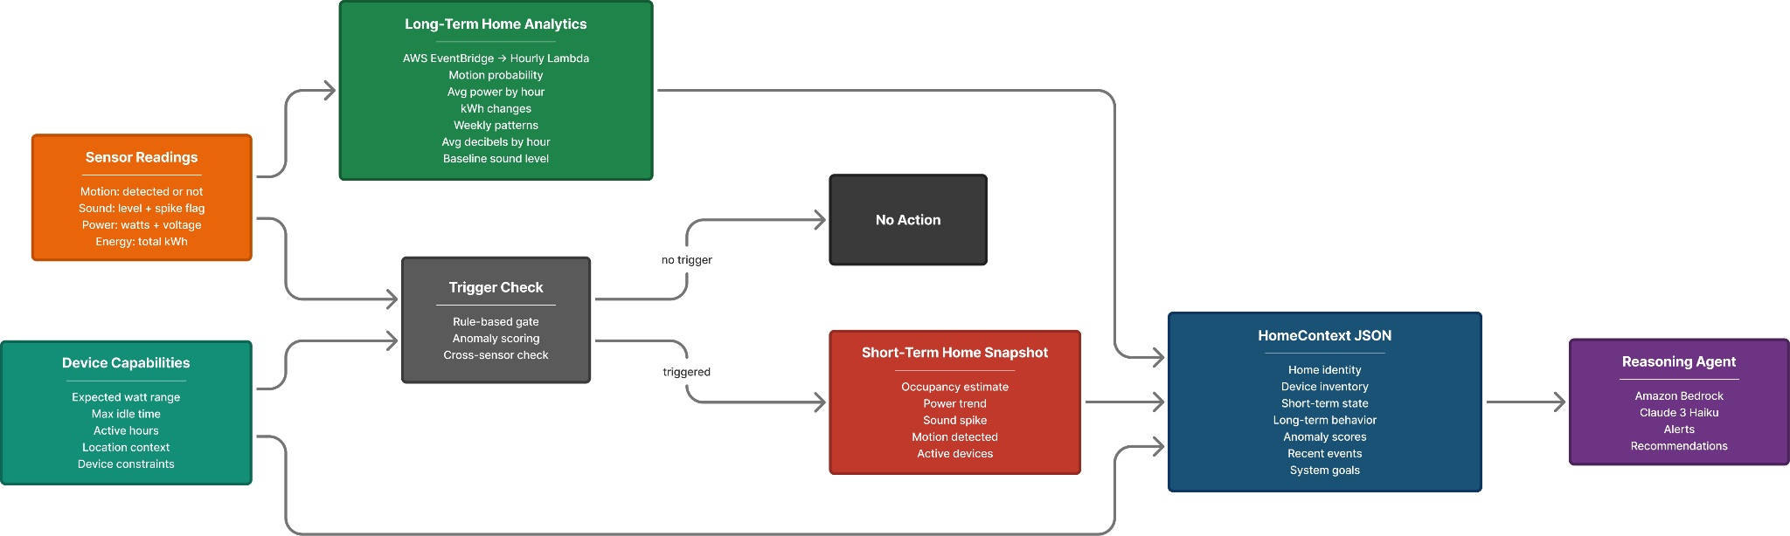
System-Level Description- AI/ML

Slide 25
Validation/Test Plan
Energy Consumption
Simulate a device drawing 4x above its hourly baseline — verify alert is triggered with correct severity
Simulate a normal HomeContext with no anomalies: verify routine recommendation is returned
Security
Simulate unexpected motion during overnight hours with occupancy set to unoccupied
Simulate concurrent sound spike and motion event — verify cross-sensor check escalates correctly
Dry run flag used to test automation output without implementing it
Final Validation
Modelt accurately classifies anomaly type based on context
Model correctly distinguishes between event-driven alerts, routine recommendation, and automation mdoes
Model correctly incorporates device schedule constraints when classifying on/off-schedule devices
SMS gate validated independently: suppresses SMS when severity is not HIGH regardless of model output

Slide 26
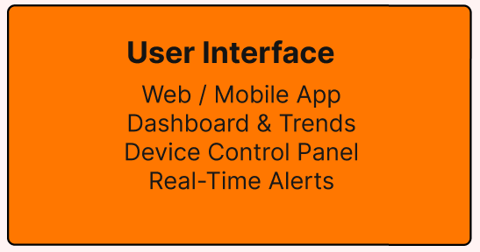
User Interface
Dashboard
Build using Home Assistant’s built-in Lovelace interface
Displays real-time energy usage, motion, and sound sensor data across all monitored units
Customizable cards and views per household unit for easy navigation
Alerts and Notifications
SMS notifications sent via a third-party SMS service (e.g. Twilio) for detected anomalies
Alerts triggered by abnormal energy usage, unexpected motion, or sound events
Configurable alert thresholds allow users to define what constitutes an anomaly
Remote Access & Scalability
Accessible remotely via Tailscale for secure out-of-home monitoring
Supports multiple household units from a single Home Assistant interface
Test
Verify real-time sensor data updates correctly on the Lovelace dashboard
Trigger a known anomaly and confirm SMS notification is sent
Validation
Data refreshes with no stale readings displayed
SMS received within a reasonable time of the event being detected

Slide 27
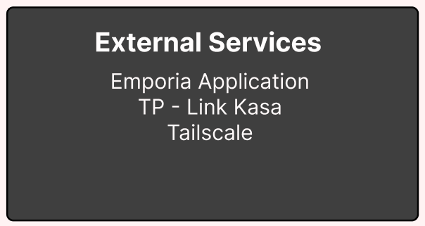
External Services
Device Integration
TP-Link Kasa smart plugs integrate directly with Home Assistant via the native Kasa integration
Emporia Energy Monitor connects to Home Assistant to capture breaker-level energy consumption for Unit 3
Data Collection
Home Assistant polls connected devices periodically
Collects voltage, current, power, and kWh readings
Network & Connectivity
Tailscale provides secure remote connectivity
Links household Pi units to the Home Assistant dashboard
Data Pipeline
All device data is routed through Home Assistant
Forwarded to the AWS RDS database via the API

Slide 28
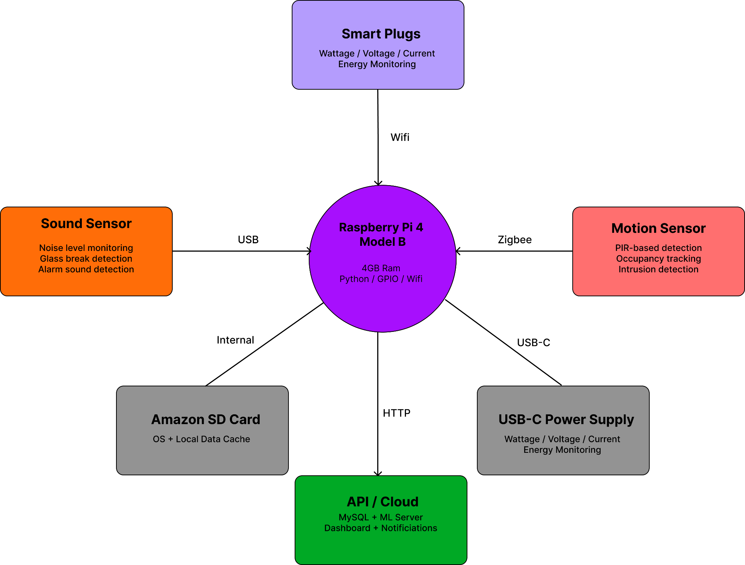
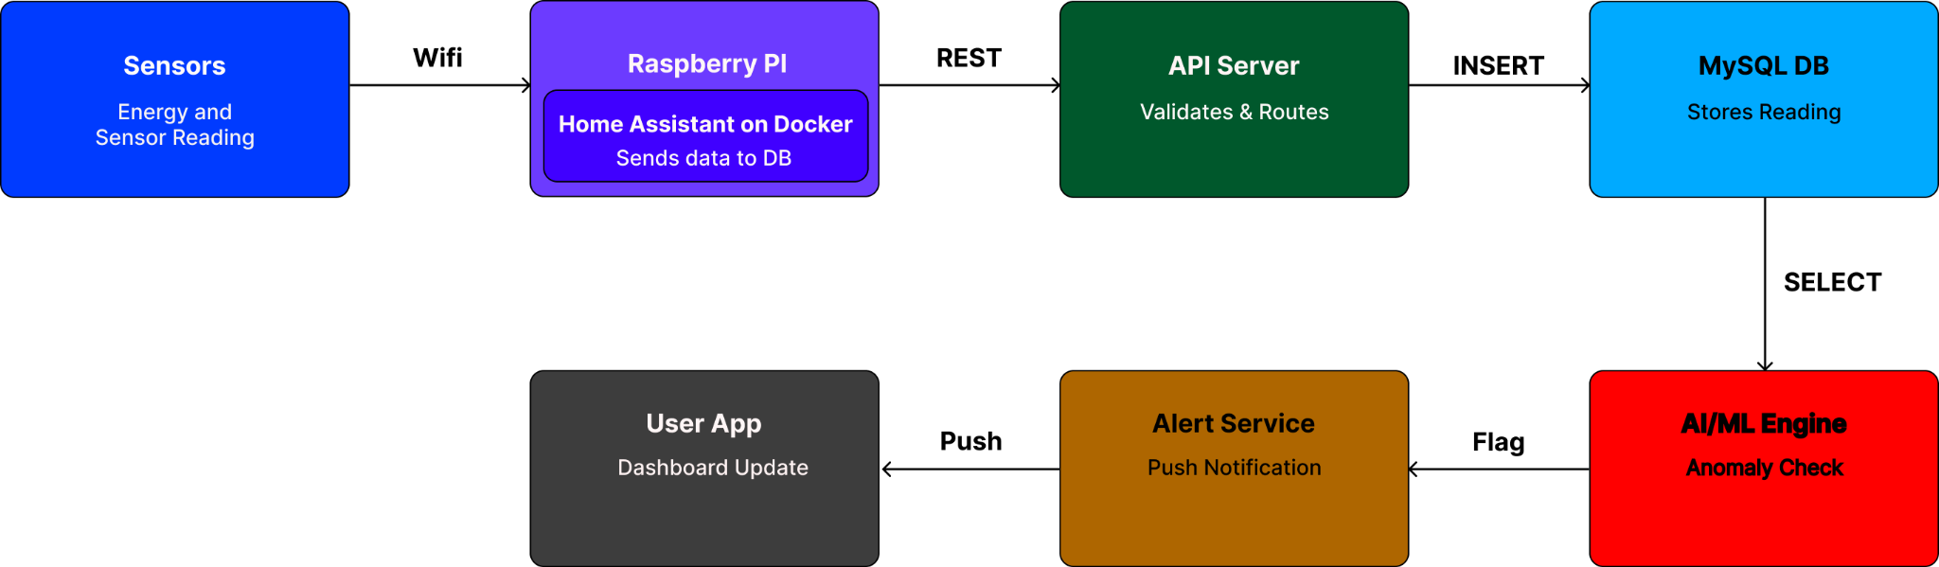
System-Level Description - Small House

Slide 29
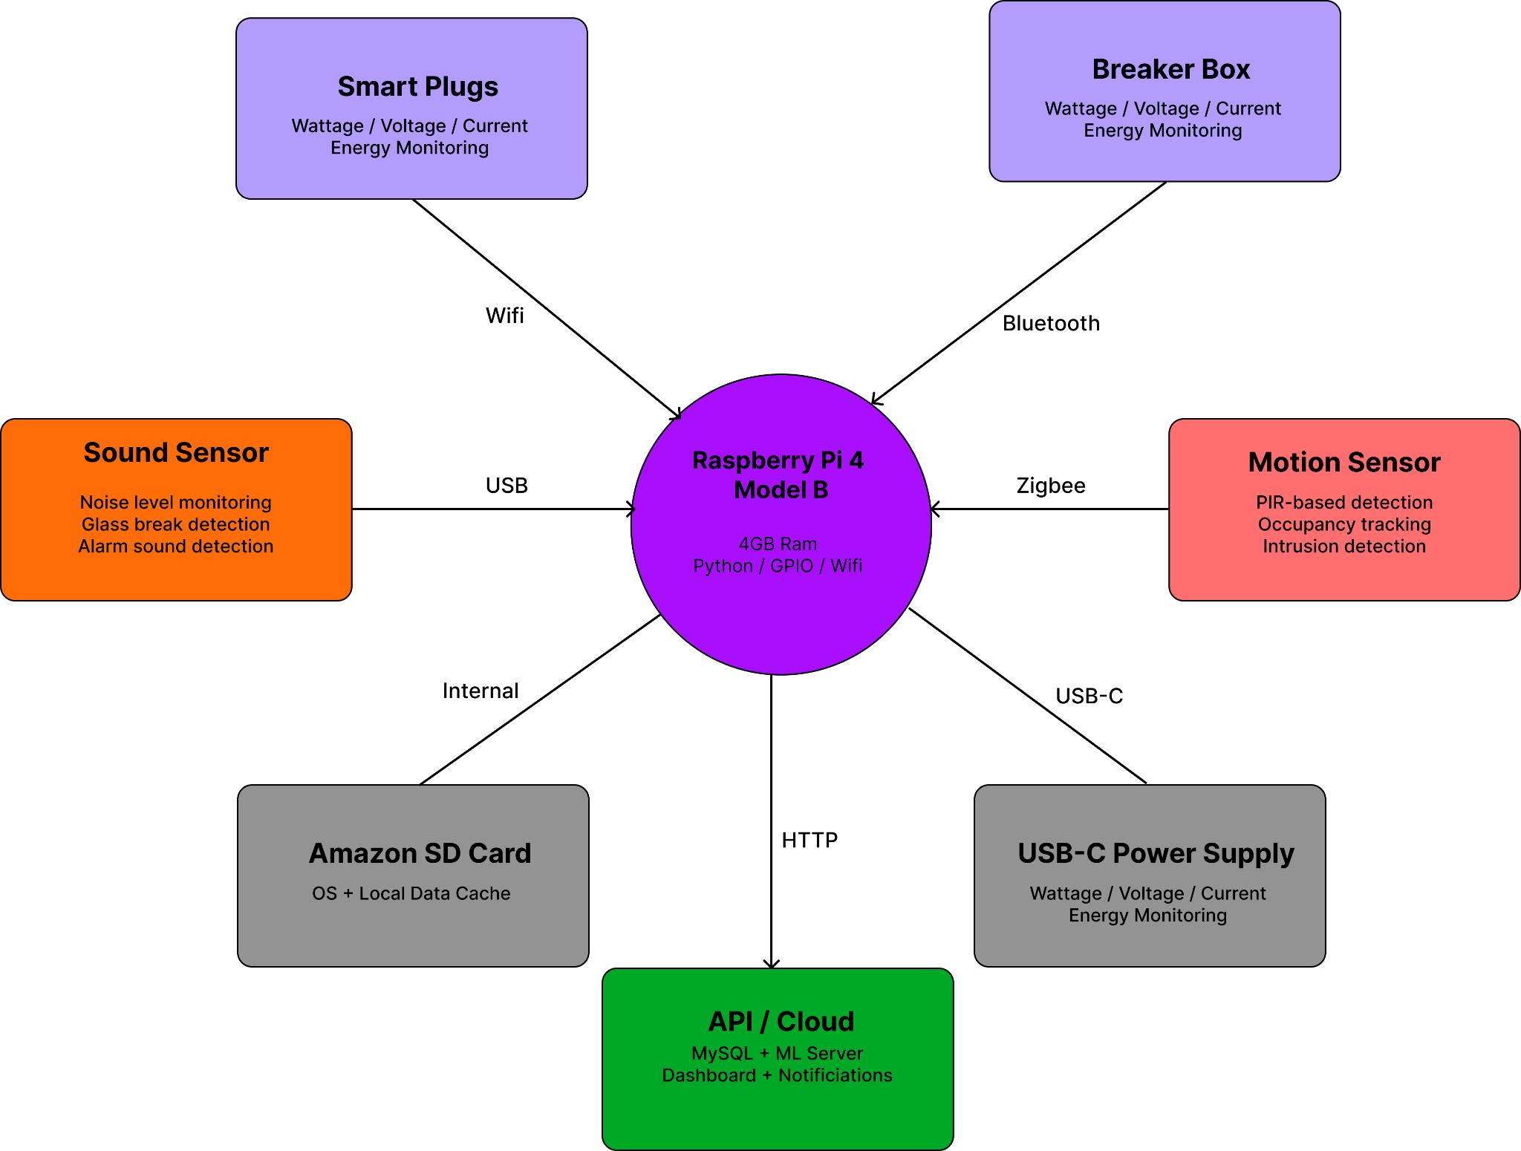
System-Level Description - Big House

Slide 30
Timeline
 | Task Name | Dependencies | Start Date | Due Date
1 | Unit 1 and 2 Setup | None | 02/26/26 | 03/06/26
2 | Unit 3 Setup | None | 03/05/26 | 03/20/26
3 | Home Assistant Configuration | Task 1, Task 2 | 03/01/26 | 03/05/26
4 | Database Setup | Task 1, Task 2 | 02/28/26 | 03/05/26
5 | Data Collection | Task 1, Task 2, Task 3 | 03/06/26 | 04/18/26
6 | API Setup | Task 1, Task 2, Task 3 | 03/08/26 | 03/20/26
7 | Database Refinement | Task 3, Task 4 | 03/18/26 | 03/28/26
8 | AI/ML Module | Task 5, Task 7 | 03/18/26 | 04/05/26
9 | User Interface | Task 4, Task 5 | 03/18/26 | 04/01/26
10 | Testing/Debugging | Task 1-9 | 04/05/26 | 04/20/26

Slide 31
Vision For Product Demonstration
Our goal was to clearly demonstrate the connection between the smart home system and the practical benefits it provides to the user. The demonstration was designed around realistic scenarios that show how the system can assist with energy savings, home monitoring, and user convenience. By walking through these scenarios, the audience can easily understand how the system observes user behavior and provides helpful recommendations or alerts.

Slide 32
Vision For Product Demonstration
Examples:
Energy saving: We will train the model to know information such as cheapest electricity times, allowing you to “set” your dryer and have it run when electricity is the cheapest overnight.
Security: We intend to implement a “vacation mode”. When the user indicates they are out of the house for a prolonged period of time, the smart home can process data differently and alert the user of any unexpected movement or sound.
Convenience: The system will be able to detect movement in a room without lights on when it knows the user is home, and based on this data can turn on the lights or any devices connected to the smart home.

Slide 33
Team Management
Frontend Software Engineer (William) has set up the Github integration with Tailscale. William has also setup the Home Assistant to run on a docker for the Raspberry PI in Unit 1. In addition, to also starting on the development of the frontend.
Machine Learning Engineer (Sriharsha) has worked on setting up AWS as well as documenting the AI models that will be used to implement the reasoning. Sriharsha has also worked tailoring data collection length to ensure that data retention is tailored towards the reasoning aspect of the project.
Lead Systems Engineer (Shiv) has worked on ensuring progress is being made and the timeline is updated respectively. Shiv has also ensured communication is consistent to all members, and also added home assistant onto a docker for Unit 2.
Hardware and Embedded Systems Engineer (Tyler) worked on setting up all the sensors and power devices in Unit 1 and the connection between the Kasa smart plugs and the phone application. Tyler also added home assistant onto a docker for Unit 3 and ensured unit 1 data was being collected.
Hardware/Machine Learning Engineer (Sutton) worked on setting up the sensors and power devices for Unit 2 and the connection between the kasa smart plugs and the phone application. Sutton also ensured that the data from unit 2 was being uploaded to the database.
Database and Backend Engineer (Evan) configured and deployed the SQL database on AWS for secure cloud storage and access. Evan also developed API endpoints for the Raspberry Pi to be able to transmit sensor data form unit 1 and 2 to the database.

Slide 34
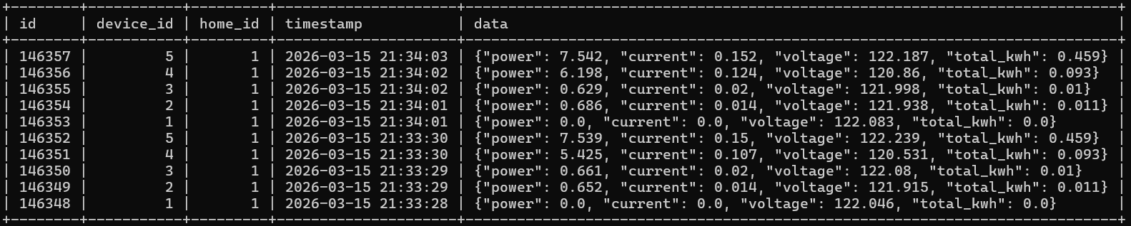
Preliminary Results

Slide 35
Thanks!
Do you have any questions?
This presentation utilized slidesgo

